Slide 1
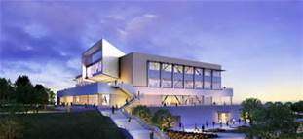
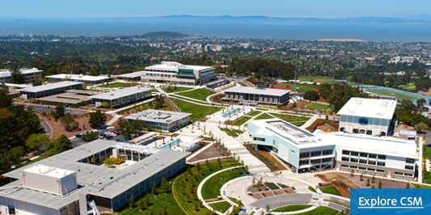
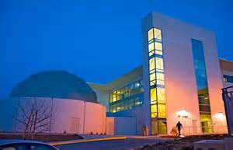
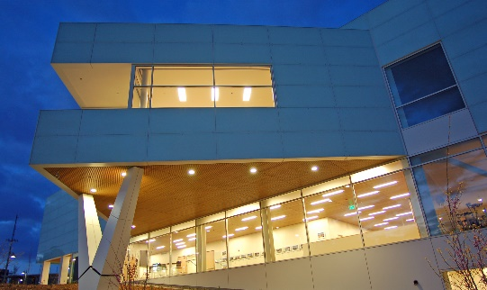
Budget Summary
5 year comparison
FY 2013-14 VS. FY 2018-19
03/06/2019
Presented by: Steve Lehigh and Jan Roecks

Slide 2
CSM Full Time Equivalent Student (FTES) summary
FY 2013-14 vs. FY 2018-19
 | FY 2013-14 | FY 2018-19 | Variance
FTES | 6,989 | 5,908 | -1,081
FTES International | 203 | 732 | 529
Total FTES | 7,192 | 6,640 | -552

Slide 3
FY 2018-19 CSM budget/
funding sources
$56.6M

Slide 4
Fy 2013-14 vs. fy 2018-19
CSM budget/funding sources
 | FY 2013-14 | FY 2018-19 | Variance
General Funds (Fund 1) & Instructional Equipment Funds | $31.9M | $45.6M | $13.7M
State and Federal Restricted Funds (Fund 3) | $4.4M | $11.0M | $6.6M
Total | $36.3M | $56.6M | $20.3M

Slide 5
CSM budget summary
FY 2013-14 vs. FY 2018-19
 | Benefits (COLA, Step & Column, STRS, PERS, etc.)
FY 1314 to FY 1415 | $1.0M
FY 1415 to FY 1516 | $1.6M
FY 1516 to FY 1617 | $2.8M
FY 1617 to FY 1718 | $2.9M
FY 1718 to FY 1819 | $3.0M
Total Ongoing Positions | $11.3M
57 Additional Positions/Release Time over the last 5 years | $9.0M
Total Increase in Benefits | $20.3M

Slide 6
CSM change in full time equivalent (FTE) staffing
FY 2013-14 vs. FY 2018-19
 | FY 2013-14 | FY 2018-19 | Variance
Administration | 13 | 13 | 0
Faculty | 129 | 152 | 23
Classified | 112 | 146 | 34
Total | 254 | 311 | 57

Slide 7
CSM Faculty (FTE) Summary
FY 2013-14 vs. FY 2018-19
 | FY 2013-14 | FY 2018-19 | Variance
Instructional | 100 | 107 | 7
Counseling | 15 | 20 | 5
Academic Supervisory | 5 | 8 | 3
Release Time (Coordination/Professional Development Leave) | 9 | 17 | 8
Total | 129 | 152 | 23

Slide 8
CSM New Initiatives
FY 2013-14 vs. FY 2018-19
Year One Promise
AB 705- Math Instructors
International Education
Student Success Support Program/Student Equity/ Basic Skills Initiative
Hispanic Serving Institute (HSI)
Strong Workforce
Math Engineering Science Achievement (MESA)
Learning Communities
Guided Pathways
Small Business Development Center

