Slide 1
LSP Update Fall 2020
CSM Library

Slide 2
Library Services Platform
Transitioning library catalog and online resources to a common software system
116 California community colleges and most CSUs and UCs
Better linking to electronic resources, increased access, increased equity

Slide 3
Important updates
Funding was not approved by the Governor in May- concerns about the state budget for 20-21
This Fall: $440K grant given to California community colleges from Academic Senate for California Community Colleges
Amounts to an 18% reduction in operating costs for the project for the next year

Slide 4
Impact of LSP on Students
Improved online access to resources for students
Improved research workflow for students by replacing third-party tools
Improved mobile presence and access
Increased equity - allowing library services to specifically support learning communities and specific programs (distribution of technology or kits)

Slide 5
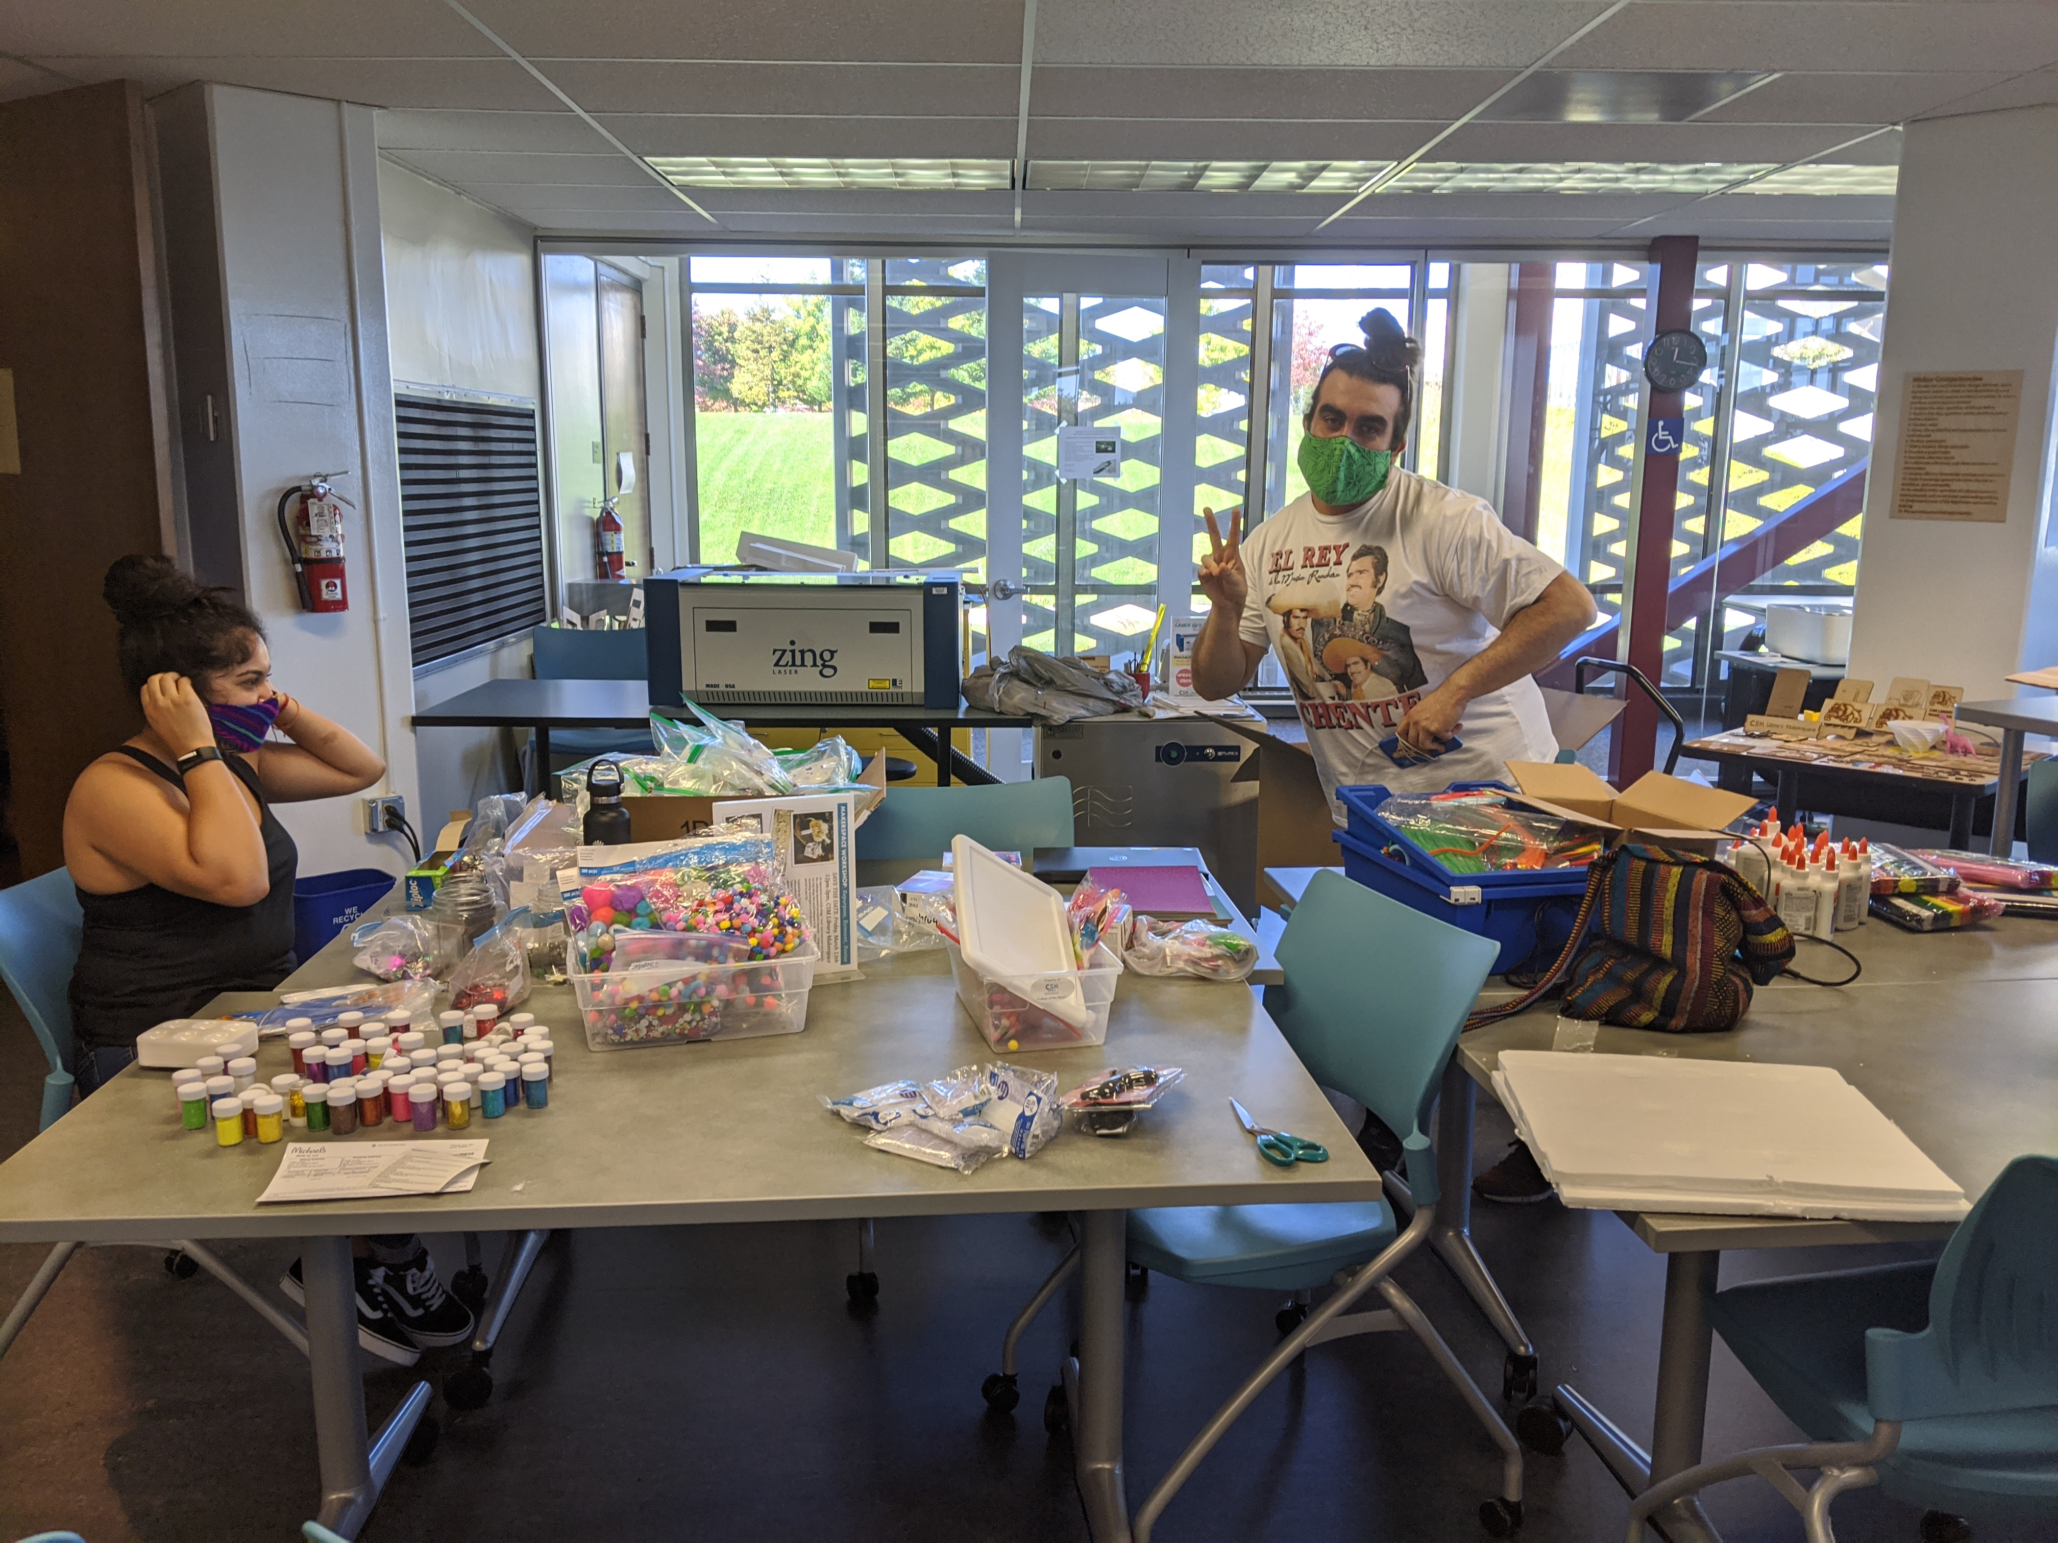
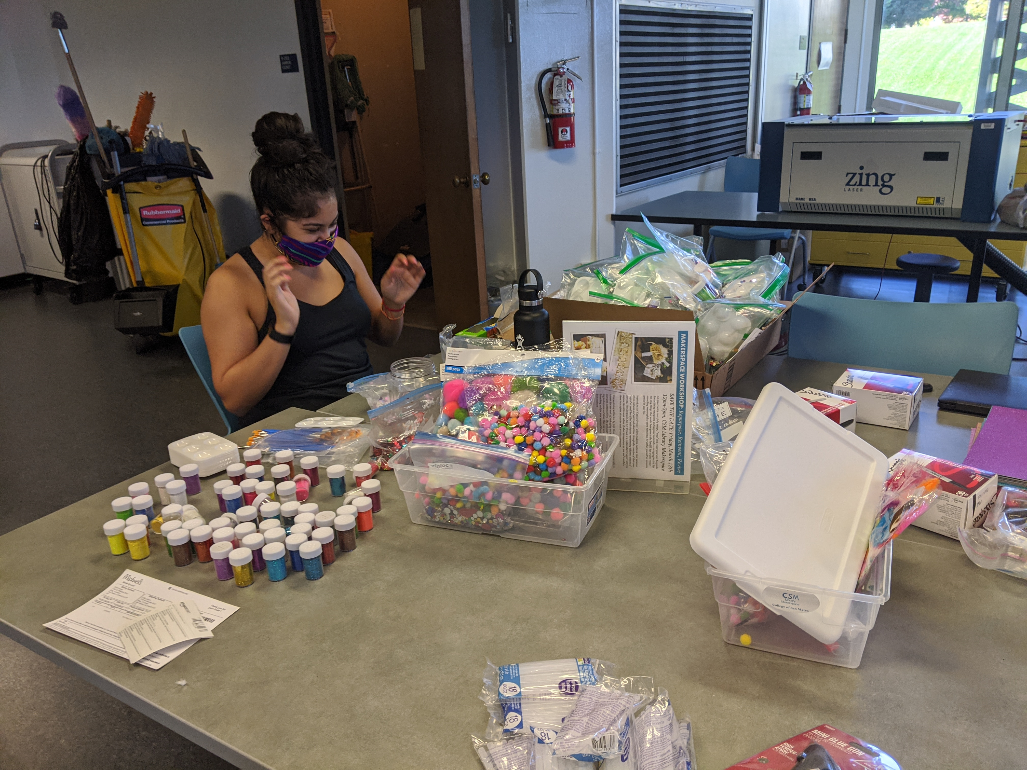
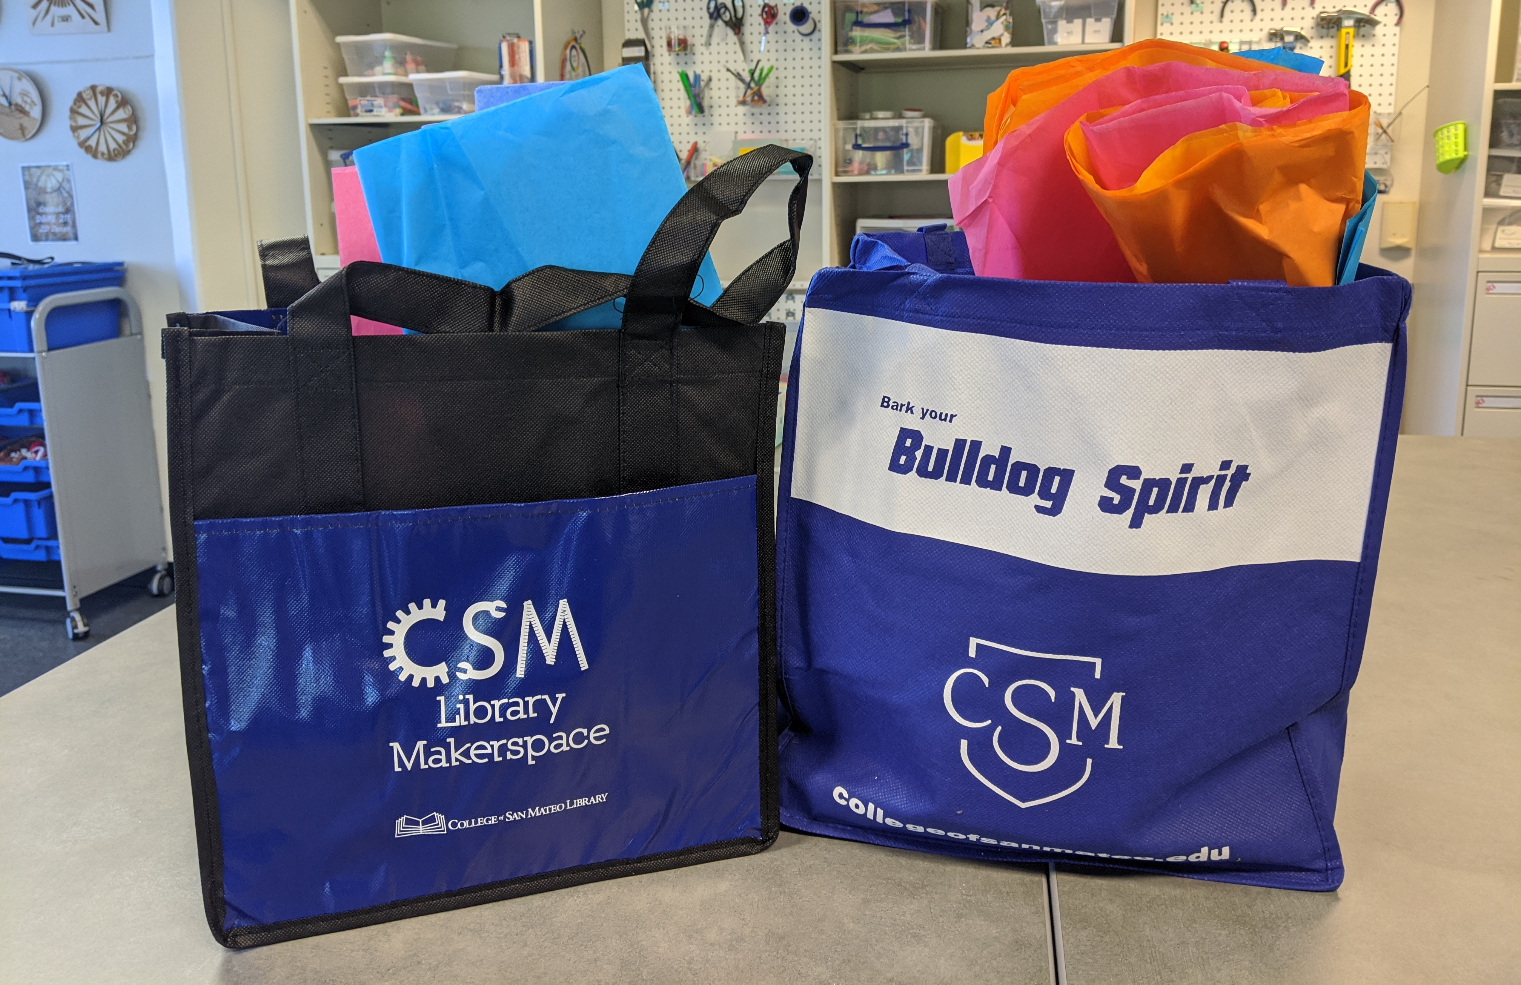
Puente Club working on their Día de los Muertos kits for curbside pick up

Slide 6
Impact of LSP on the Campus
Improved workflow for staff on the ground
Enabled curbside services to get up and running
Enabled other departments, including ITS, to add and track equipment and resources quickly and easily
Serving as the main tracking system across the district for loaned equipment and resources

Slide 7
Impact of LSP on our Community
Ability to make changes locally that would have previously been difficult to impossible
  Example: Subject heading changes

Slide 8
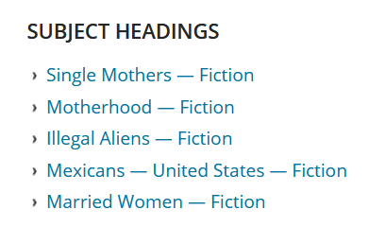

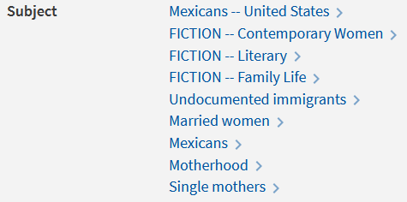
PLS catalog subject headings
CSM/SMCCD subject headings

Slide 9
Special thanks to our Academic Senate president, Arielle Smith, and the entire Academic Senate for the continued support for the LSP project.
Our Senate has be supportive from day one and continues to support the library in its mission to improve issues of access, equity, and technology to all of our students.

