Slide 1
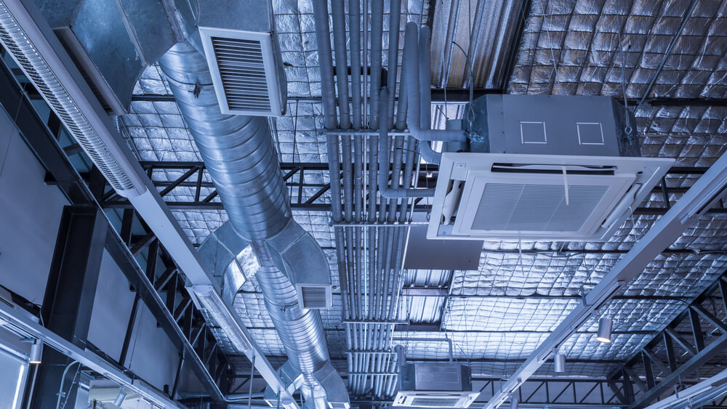

COVID Response & HVAC/Ventilation
Facilities Excellence
Professionalism * Communication * Customer Service * Teamwork

Slide 2
SMCCCD COVID-19 Procedures Recovery Phase
Personal Protective Equipment - How to Obtain PPE (https://smccd.edu/return-to-campus/employees.php#ppe )
Sanitization – General Strategies
Community Spaces, Classrooms and Labs, Offices
Requesting Supplies
Ventilation HVAC – Facilities Response to COVID
Air Purifiers – Distribution Criteria
COVID Website: https://smccd.edu/return-to-campus/
Facilities Excellence
Professionalism * Communication * Customer Service * Teamwork

Slide 3
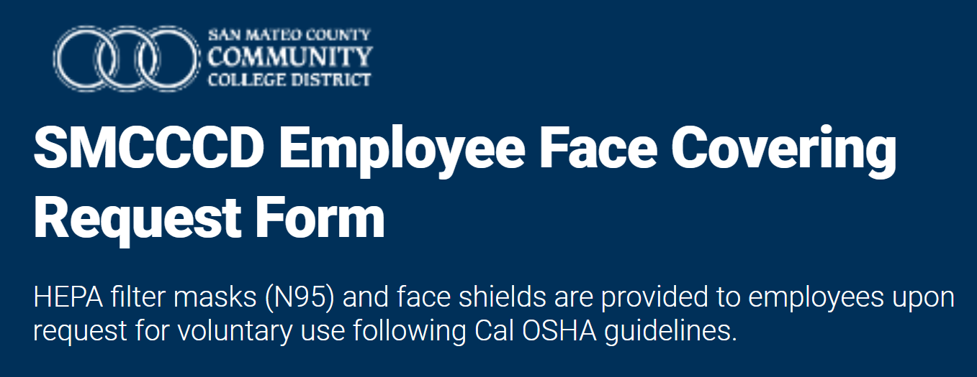
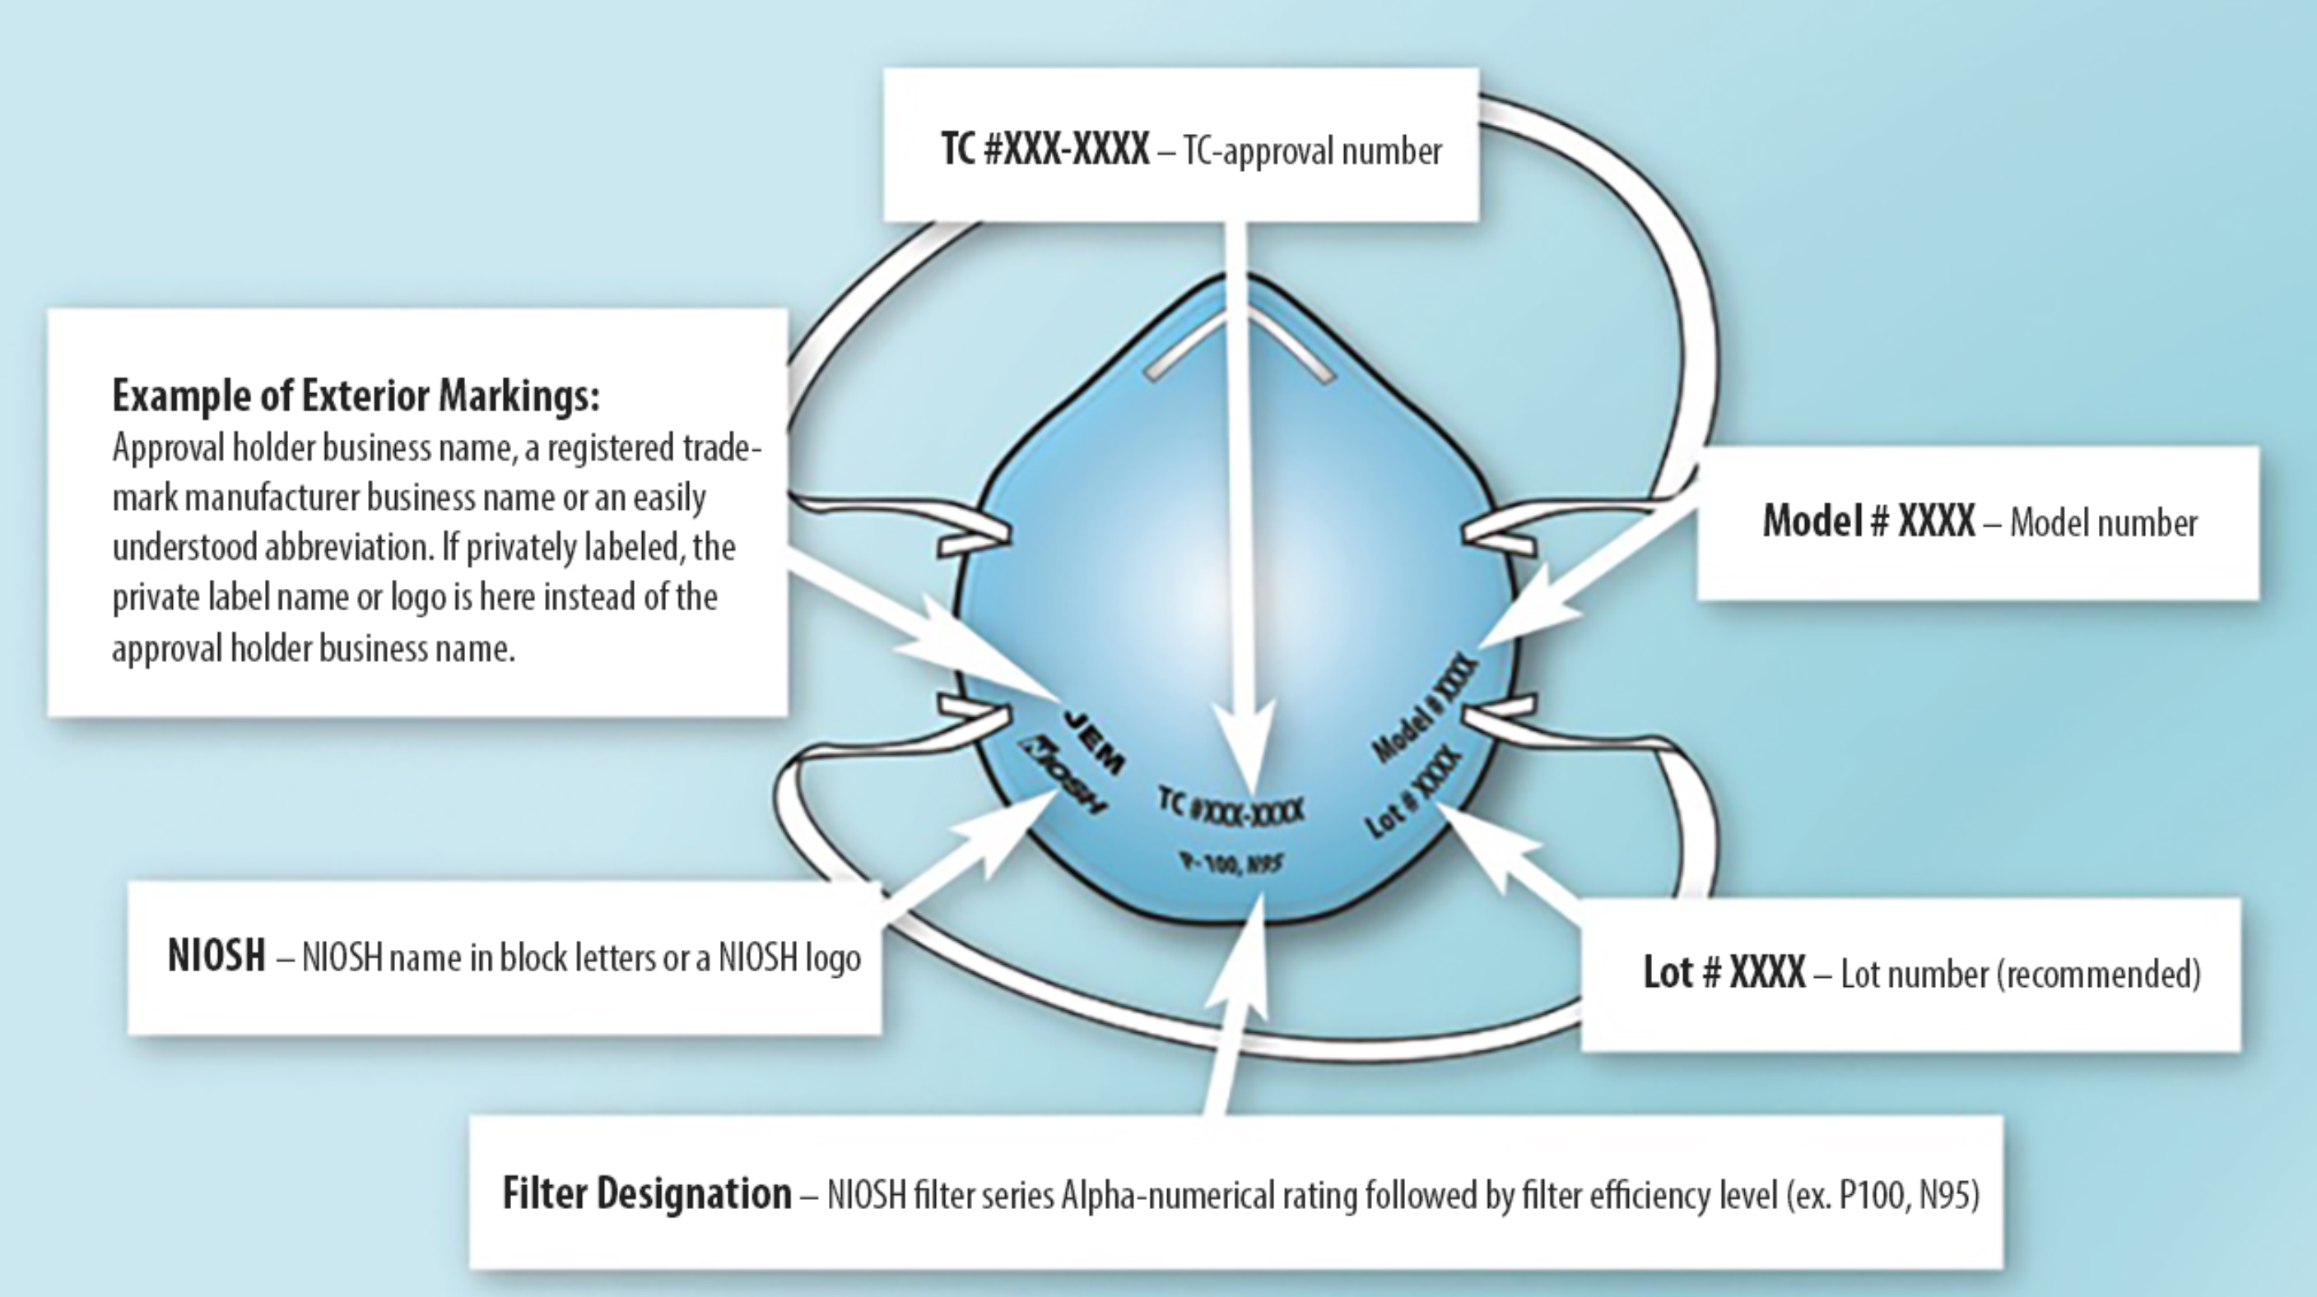
Personal Protective Equipment
https://smccd.edu/return-to-campus/employees.php#ppe
N95 Respirator
Request from the District
https://app.smartsheet.com/b/form/be7e34cd732b44c8b910b42af93f22a1
https://www.cdc.gov/niosh/npptl/topics/respirators/disp_part/default.html

Slide 4
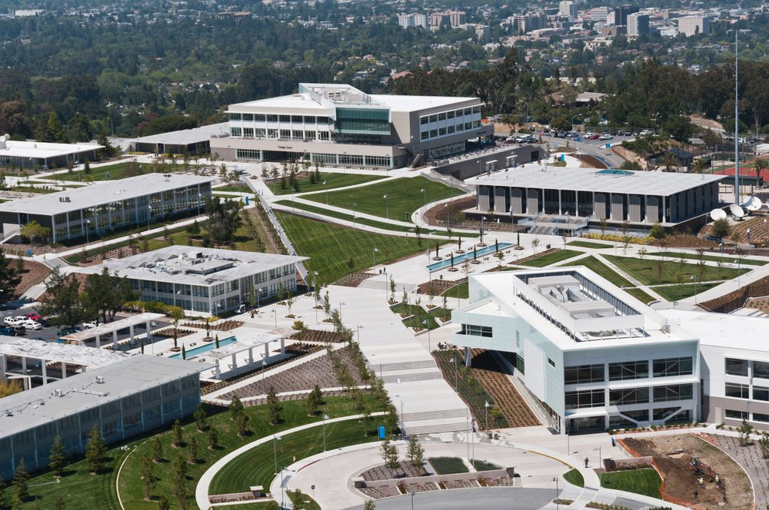
Discussion Topics: Air Quality & HVAC
District Precautions and Resources
Ventilation& Filtration
Mechanical & Natural
Air Purifiers

Slide 5
HVAC System Best Practices and COVID Response
Confirmed that all HVAC meets or exceeds California Building code requirements
ASHRAE 62.1 and Title 24
Adhered to CDC and OSHA Recommendations
Information Posted on Website
Buildings Ventilation Website
Buildings Ventilation and Filtration Reports
https://smccd.edu/return-to-campus/facilities-safety.php
Facilities Excellence
Professionalism * Communication * Customer Service * Teamwork

Slide 6
SMCCCD – Ventilation Highlights
All District buildings meet or exceed ventilation code requirements
Large air handling units (AHU) have outside air dampers that bring in fresh air for the whole building or a large portion (zone) of a building
Building Management System (BMS) monitors proper and efficient operation HVAC systems
Portable HEPA air scrubbers are provided in areas with insufficient ventilation, health centers, child development centers, and spaces where occupants with higher health risks reside as determined by HR ADA accommodation process.
Title 24 and ASHRAE 62.1 standards -Mechanical and/or Natural Ventilation
CAL OSHA refers to ASHRAE 62.1 and Title 24 for guidance
Larger air systems (AHUs, Fan Coil Unit (FCUs) serving multiple areas) have been inspected for proper fan, damper and valve operations to ensure proper ventilation.
The schedule for air handling systems were reviewed and updated to run 2 hours before and after building occupancy for pre- and post-occupancy purging.
Air filters across the campuses were inspected and replaced with MERV 13 (or highest appropriate efficiency filter compatible with the system)
Outside air dampers introduce as much outdoor air as possible without negatively affecting space temperatures.
Each space in the campuses has been evaluated for proper ventilation and deficiencies. Portable HEPA filtration devices are provided to areas deemed insufficient or of higher risk.
Not on BMS – and small portable or ancillary buildings; SKY B9, B10, B14, B19; CSM – B33; CAN B19-21
BMS provides monitoring, control, and trending of most systems and thousands of data points across the campus to ensure proper system function
Deficiencies are addressed
Air scrubbers are proven effective but do require regular filter changes and other preventative maintenance steps to ensure optimal performance

Slide 7
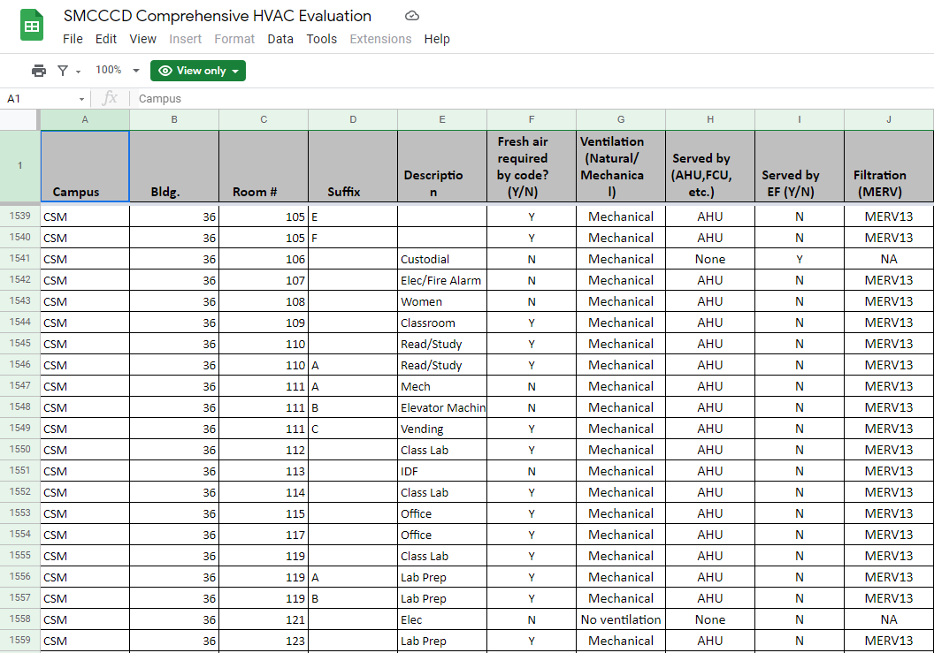
HVAC Comprehensive Evaluation
Exported Room Data from FUSION
Identified and Mapped HVAC Systems
Noted Filtration Ratings
SMCCCD Comprehensive HVAC Evaluation Website: https://sites.google.com/my.smccd.edu/smcccdsustainability/air-and-environmental-quality/indoor-air-quality
COVID Website: https://smccd.edu/return-to-campus/
Facilities Excellence
Professionalism * Communication * Customer Service * Teamwork

Slide 8
Air Scrubbers/Air Purifiers
District is required to provide a healthy and safe work environment including code compliant ventilation.
Established Criteria for the Use of Air Purifiers
Areas with insufficient or difficult to validate ventilation
Campus Health Centers - Sick people will visit
Child Development Centers-Little people can’t be vaccinated
HR ADA Accommodation Process
Bringing in Personal Air Purifiers
Facilities actively discourages this. However if people insist, then we gave instruction to plug directly into the wall (Fire Marshal Requirement) and purchase an unit that is UL rated and does not produce ozone.
Facilities Excellence
Professionalism * Communication * Customer Service * Teamwork

Slide 9
Thank You Questions?
Facilities Excellence
Professionalism * Communication * Customer Service * Teamwork

